Slide 1




Perancangan Sistem Inventory Elektronik Komputer
Ricardo Lim 221510004

Slide 2
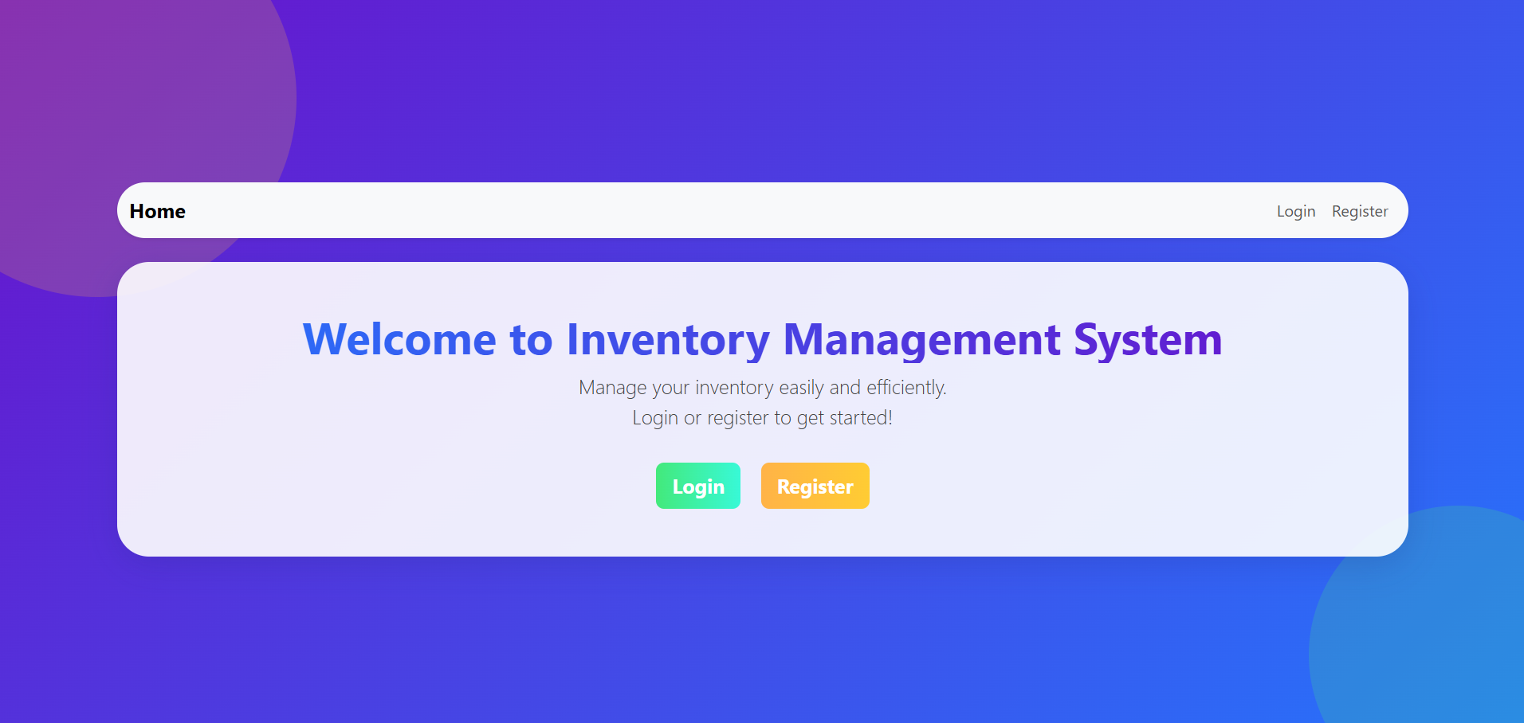
Tampilan Home

Slide 3
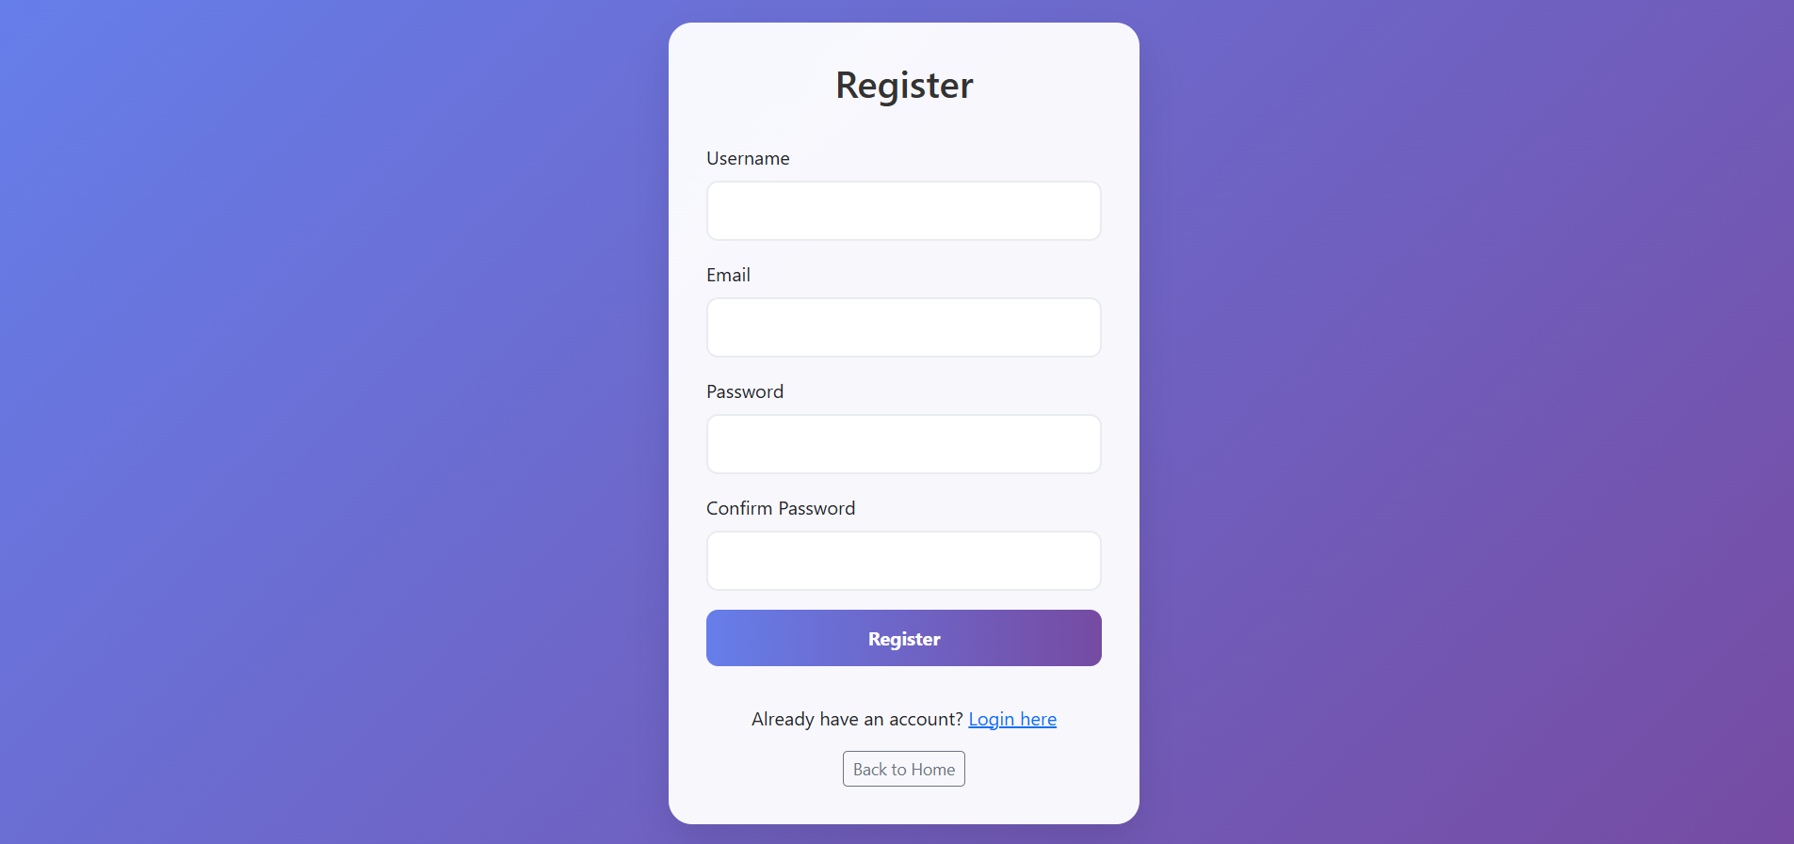
Tampilan Register

Slide 4

Tampilan Login

Slide 5
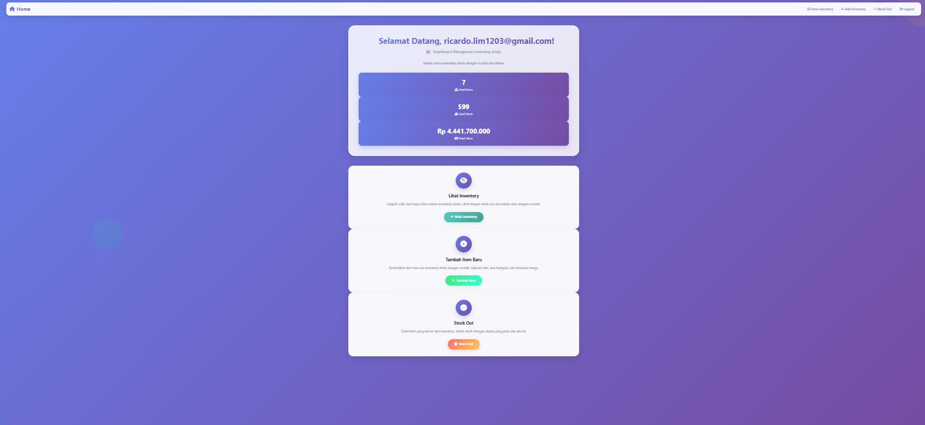
Tampilan Dashboard

Slide 6
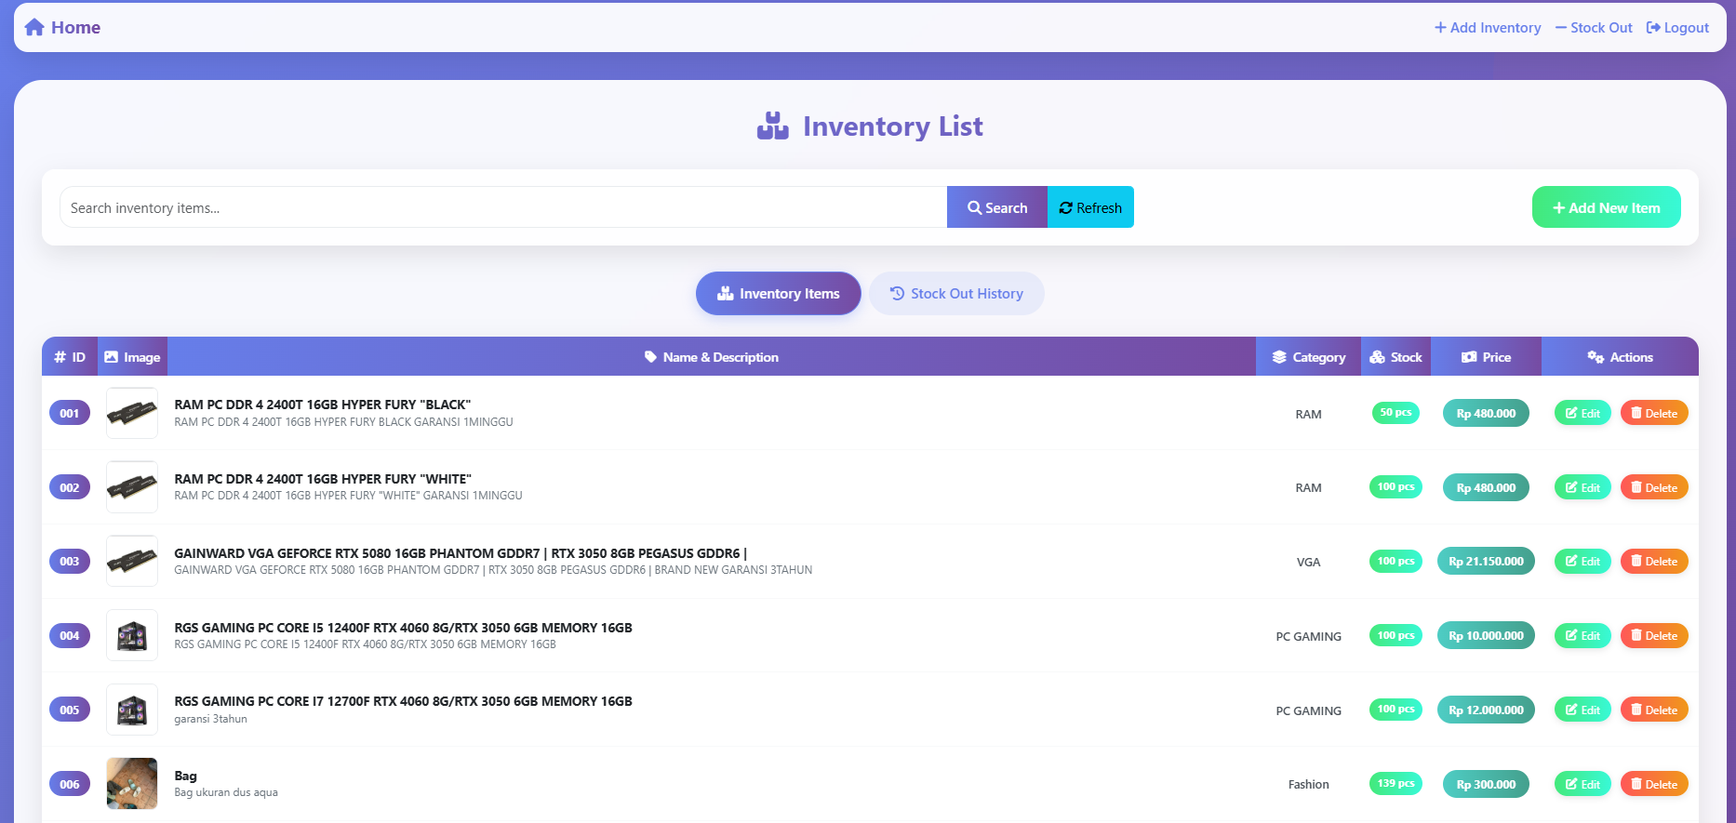
Tampilan View Inventory

Slide 7
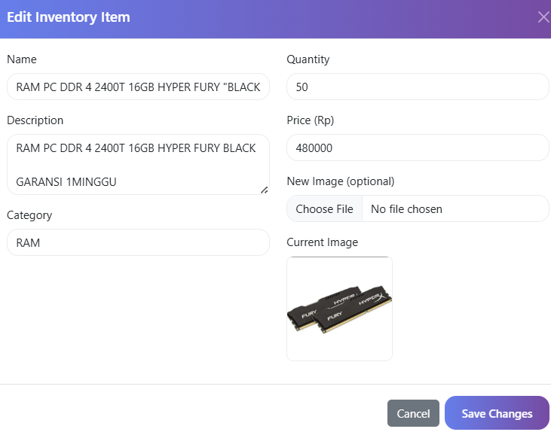
Tampilan Edit Inventory

Slide 8
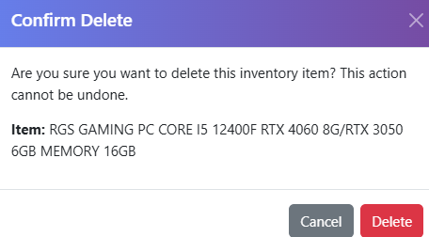
Tampilan Delete Inventory

Slide 9
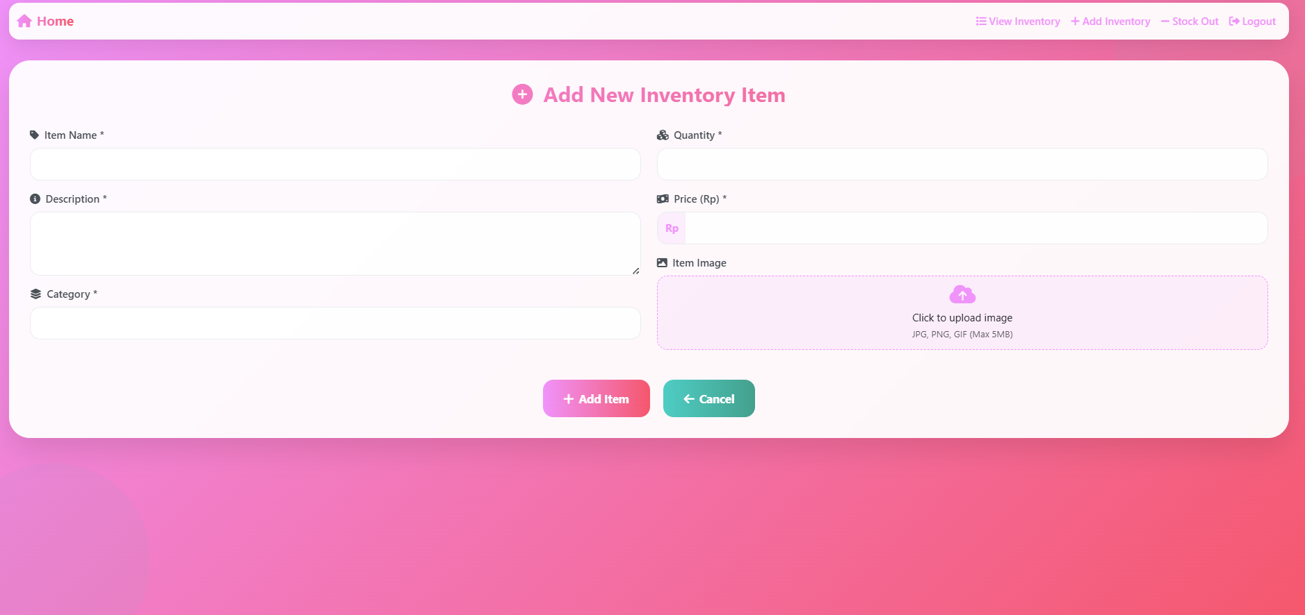
Tampilan Add Inventory

Slide 10
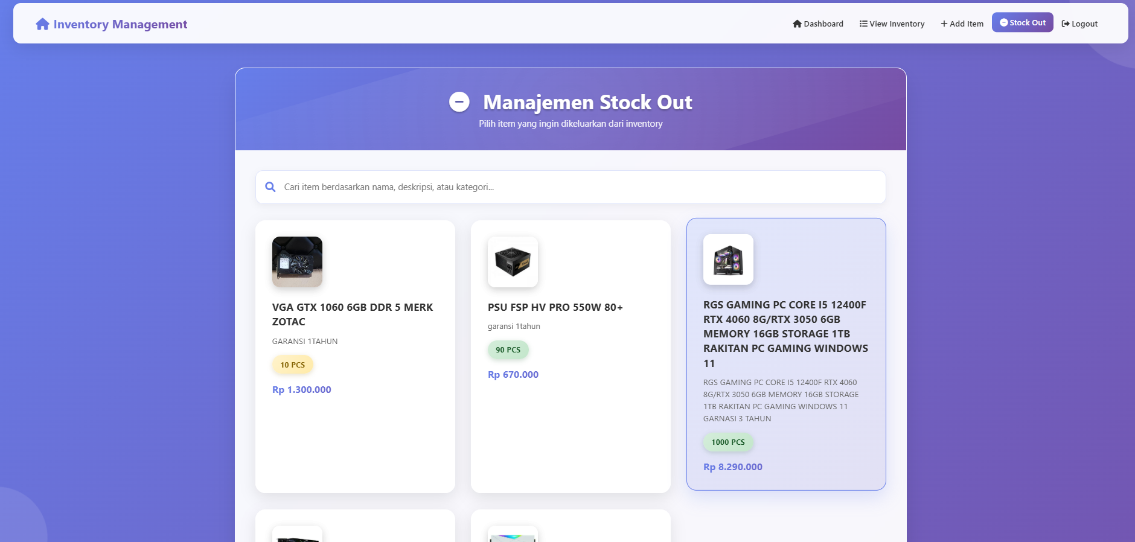
Tampilan Stock Out

Slide 11
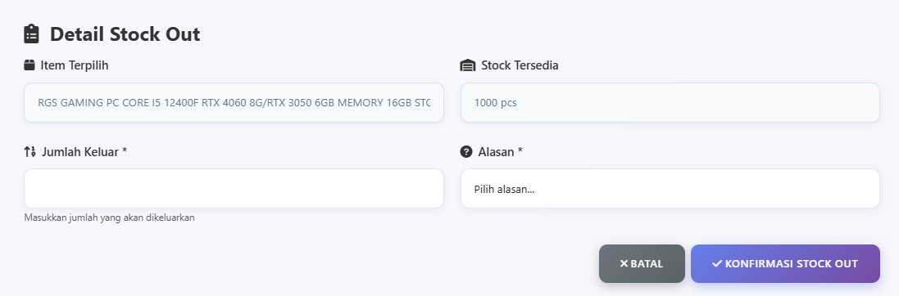
Tampilan Detail Stock Out

Slide 12
LINK HOSTING
https://inventory-app-12634.web.app/

Slide 13
Ricardo Lim (221510004)
TERIMAKASIH

